Slide 1
Cyber Security Apprenticeship
Webinar
20 March 2025
Notes:
Standard title slide

Slide 2
Agenda
10.00am: Welcome and introductions - Mark Dimock, Regional Cyber Lead,
10.05am: Cyber Improvement Programme – Claire Kirk, Head of Cyber Workforce
10.10am: Cyber Apprenticeship programme – Liz Sahu, Cyber Apprenticeship Lead
10.20am: Delivering the Cyber Apprenticeship – Ben Black, BPP
10.35am: The apprentice perspective – Pete Robinson, Regional Cyber Lead
10.40am: Questions
11.00am: Close

Slide 3
Context
Cyber sector businesses reported that they find positions for staff with 3 to 5 years of experience the hardest to fill and 61% of job postings request 2-6 years of experience.
DSIT (Department for Science, Innovation and Technology) estimate a total of 11,600 new cyber professionals are required each year: 6800 to meet new demand and 4800 to replace those exiting the sector. A total of 8100 individuals entered the workforce in 2023 leaving a shortfall of 3500.

Slide 4
Evidence
During a survey undertaken last year, it was identified that training is needed for those not from cyber backgrounds who now find themselves in cyber
Access to accredited learning is limited for many NHS cyber professionals due to budget constraints
Cyber professionals fear not keeping up with industry developments
In a recent survey of NHS organisations, when asked how easy it is to recruit cyber professionals, 100% rated it either “somewhat difficult “or “extremely difficult”
Bands 6-8a were cited as the most difficult to recruit to
Candidates with relevant experience are particularly hard to find
There are a number of cyber apprenticeships and suppliers available to you

Slide 5
Cyber Security Apprenticeship
Level 4
Presented by:
Liz Sahu – Apprenticeship Lead (Cyber Security Workforce)
NHS England
Liz.sahu1@nhs.net
07734629556
Notes:
Standard title slide

Slide 6
The NHS Cyber workforce… growing our own
NHS England is seeking to attract and retain our cyber workforce in the NHS
Apprenticeships can help…
Apprenticeships can start, and develop your whole cyber career
Apprenticeships can be used to create a career pathway for cyber professionals (and other digital professions)
The training cost of an apprenticeship is paid for by the apprenticeship levy (no payment needed from your departmental budget)
Apprenticeship programmes can include industry qualifications in addition to the apprenticeship at no extra cost

Slide 7

What is an apprenticeship?
Hands-on experience alongside ‘off-the-job’ training
A full-time employee (30hrs+) would spend a minimum of 6hrs a wk ’off the job’
Set timeframe between 1- 6 years
Open to everyone over the age of 16 years
Additional qualifications & certifications including degrees may be included
Notes:
Plain slide with subhead and bullets

Slide 8
Why Apprenticeships?
They are employer led… (i.e. led by you, the employer)
Apprenticeship standards are designed by employers and are based on occupations i.e. cyber apprenticeship standards are based on the cyber occupations. They are regularly *reviewed by employers to ensure they still meet their needs
Apprenticeships meet the needs of your organisation as they are designed by organisations that require staff to have those skills (Trailblazer groups)
Apprenticeships offer opportunities to upskill and develop current employees:
  Equip your current staff with the right skills
  Ensure your staff have the knowledge and skills to deliver new services & support
  Apprenticeships can be used to recruit a diversified talent pool – i.e. those with few traditional qualifications
  Apprenticeships increase retention & engagement
  (Nursing student attrition: 30% degree vs 3% degree apprenticeship)
  Support career pathways – L3 Cyber L4 Cyber L6 Cyber (degree)

Slide 9
Creating Cyber Career Pathways…using apprenticeships (& T Levels)
Level 3
T level
Level 4
Apprenticeship
Level 6 Apprenticeship
(Degree level)
Digital - Cyber Security
Cyber Security Technologist
- 24 mths
Cyber Security Technical Professional Degree
- 48 mths
Level 3
Apprenticeship
Level 4 Apprenticeship
Cyber Security Technician
– 18 mths
Digital Forensic Technician
- 24 mths

Slide 10
How is the learning funded?... Through the Levy
All employers with a yearly wage bill over £3 million pay 0.5% of their wage bill into an account which then becomes their Apprenticeship Levy fund
Your organisations levy funds 100% of the education costs (not salary costs) of the apprenticeship programme.
Your organisation has 24 months to spend its levy funds or they expire and return to the Government
Combined NHS Levy fund is over £220 million per year, in 20/21 the NHS used £185 million of its levy.
Speak to your Apprenticeship Lead to find out more
Notes:
Plain slide with subhead and bullets

Slide 11
Apprenticeships grow and develop your team...
Step 1: Identify the workforce development needs in your team?
Are there skills gaps in your workforce and is the current qualification level relating to their role sufficient?
Step 2: Identify your apprenticeship experts
Your Trust will have an ‘Apprenticeship Lead’, they normally work within the Training or HR functions. Your apprenticeship lead will be able to advise you on how to enrol staff onto apprenticeship programmes.
Step 3 – Secure funding (Levy) to pay for the learning (not salary)
Your Apprenticeships Lead will be able to arrange this for you.
Notes:
Plain slide with subhead and bullets

Slide 12
Cyber apprenticeships:
Current cyber apprenticeship standards available:
Standard | Level | Duration | Levy Cost
Cyber Security Technician | 3 | 18 months | £11,000
Cyber Security Technologist | 4 | 24 months | £18,000
Digital Forensic Technician | 4 | 24 months | £18,000
Cyber Security Technical Professional (Integrated degree) | 6 | 48 months | £24,000
Advanced Digital Forensic Professional | 7 | 36 months | £27,000

Slide 13
Cyber apprenticeships – supporting a career pathway
NHSE is working with BPP (Firebrand & Estio) to deliver an NHS contextualised Level 4 Cyber Technologist Apprenticeship programme across England.
https://www.instituteforapprenticeships.org/apprenticeship-standards/st1021-v1-0
The apprentices will be existing NHS IT staff who are looking to develop into a cyber role.
The apprenticeship will be a ‘closed cohort’ and therefore the content will be contextualised to the NHS.
The programme can also include the following certifications: CompTIA Network, CompTIA Security+ and EC-Council Certified Network Defender
The apprenticeship programme starts in Sept ’25
Expressions of Interest (EoI) will be through BPP once you have the agreement of your Manager and Apprenticeship Lead
An ‘apprentice community’ will also be created, aided by guest speakers from the cyber digital world

Slide 14
Next Steps:
Prospective apprentices: speak to your line manager and seek their approval
Line Managers: Speak to you Apprenticeship Lead. If you are unsure who that is, I will help you locate them ☺
If you’d like to know more about the programme please speak to BPP
Once your line manager & apprenticeship lead are supportive, contact BPP to complete an Expressions of Interest (EoI)

Slide 15



CYBER SECURITY TECHNOLOGIST LEVEL 4 (HEALTH & CARE)

Slide 16

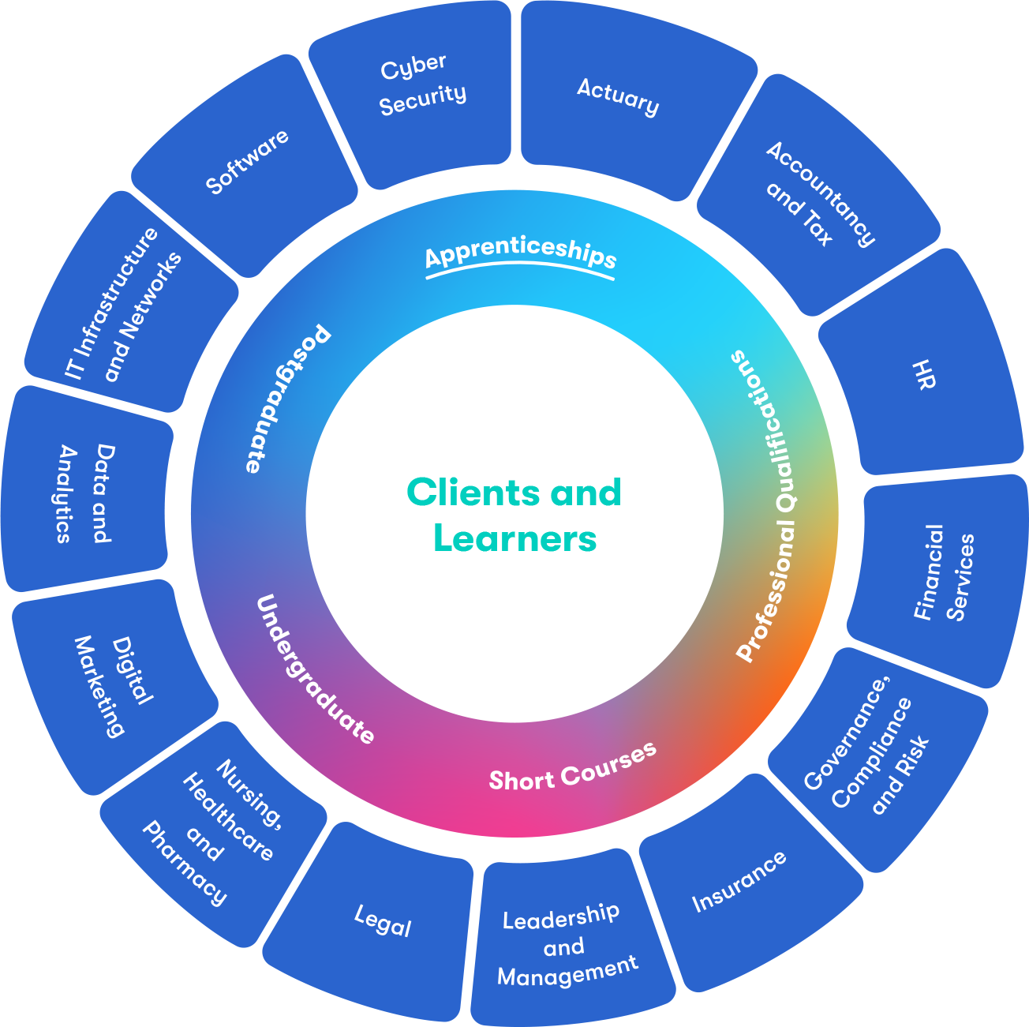






BPP Education Group
Leading and innovating the educational landscape for more than 45 years
In 2007 we are a fully accredited university with​
Degree awarding powers
Ofsted rated as good in 2022 7 2024
Sector experts, continuously conducting thought-leading research and researching the latest from industry bodies allow us to identify relevant training and future proof our partner’s businesses
Trusted by the sector - Trained over 2000 NHS apprentices over the past five years and work closely with NHS Trusts and NHS England
BPP combined with Firebrand and Estio make us the largest Digital and Tech provider in the UK

Slide 17




Not Just and IT Provider…
4000+
Apprentices supported on digital apprenticeship standards since 2015
96%
Pass rate across all apprenticeship standards
90%
retention rate for apprentices on all standards
33%
of apprentices gain a Distinction with Firebrand
23
Years of delivering digital training
135,000+
Industry professionals achieved certifications since 2001
1000+
Courses in our training portfolio to meet requirements
2
Current Ofsted grade (April 2024)
BPP Education Group named Apprenticeship Provider of the Year 2024
Firebrand named one of the top 20 IT training companies for the previous 13 years running
Estio named winner of
Digital Apprenticeship Provider of the Year 2022

Slide 18
25 years In Industry: Starting back in 2000, Firebrand has been at the forefront of digital training, always growing and changing with the times.
Industry-Recognised Certifications: Partners with leading vendors like Microsoft, AWS, and Cisco, ensuring learners gain relevant, in-demand qualifications.
Hands-On, Immersive Training: Provides immersive, instructor-led training experiences with practical labs and real-world scenarios.
Flexible Delivery Options: Offers both in-person and online training options, accommodating different learning preferences and business needs.
Proven Track Record: Strong reputation for high pass rates, with many successful learners and corporate clients across various industries.

Slide 19






















Our Partners

Slide 20
CYBER SECURITY TECHNOLOGIST LEVEL 4
(HEALTH & CARE)
PROGRAMME INFORMATION

Slide 21














Cyber Security Technologist Level 4 Programme
Course Starts
Duration 24 months
Association of Apprenticeships
AoA Connect
AoA Learn
AoA On-Demand
Rational for Security Objectives
Ethical Principles, Codes of practice, Law and Regulation
Year 1
1
2
3
3
4
5
6
7
e-Learning courses
Cyber Security Concepts and its Importance to Business and Society
Cyber Introduction
8
Python Fundamentals
CompTIA Security+
Preventing Security Breaches and Continuous Improvement
Year 2
9
15
14
13
12
11
10
4
16
4
4
4
Operation of Security Management Systems and Incident Response
Following Organisation’s Policies & Processes
CompTIA Network+
17
EC-Council Certified Network Defender
18
19
20
21
22
23
24
End Point Assessment
Portfolio Finalisation
Gateway Submission
Scenario Demonstrations with Questioning
Professional Discussion Underpinned by Portfolio
Project Report
Knowledge Test
Grade Profile
Programme Achievement
1
Month
Colleague Mentor Progress review
Online Learning
4
Residential days training
Work-based Projects
Portfolio Review
Synoptic Projects
Final Interview

Slide 22



Vendor Qualifications
CompTIA Network+
  Validates the core skills necessary to establish, maintain, troubleshoot and secure networks in any environment, preparing learners for a rewarding career in networking and cybersecurity
CompTIA Security+
  A global certification that validates the baseline skills necessary to perform core security functions and pursue an IT security career.
EC-Council Certified Network Defender
  Vendor neutral
  Learning to defend computer networks and operating environments

Slide 23

Residential training facility – Wyboston Lakes (Bedfordshire)
STATE OF THE ART TRAINING FACILITY
75 ensuite bedrooms with free Wi-Fi access
9 purpose-built classrooms
24/7 access to classrooms and labs
Dedicated fibre line for uninterrupted remote lab access
PHYSICAL ON-SITE LABS WITH DEDICATED KIT FOR HANDS-ON TRAINING
24/7 SAFEGUARDING LEAD
FREE ACCESS TO ON-SITE GYM
3 MEALS A DAY IN HOTEL RESTAURANT
NO CHARGE FOR ACCOMODATION/ FOOD

Slide 24



Online Instructor Led – OIL
Classroom BASED Training Delivered Online
Live instructor view on camera, including whiteboard
Online Exam Preparations Sessions
Online tools to ask and answer questions
Group chat to discuss topics in real-time
Classroom audio including onsite questions from fellow students
Online Exam Technical Support
Virtual and hybrid classroom has all the benefits of classroom study without the hassle and cost of travel.
You'll get full interaction with the learning professional throughout the course, using high-quality audio equipment and the Cisco WebEx platform.
Our online instructor led courses allow you to access classroom training, without leaving your home or office.

Slide 25
OUR TEACHING, COACHING & SUPPORT
INSTRUCTOR
Delivers residential training (core knowledge + skills)
Vendor certified and approved
24/7 safeguarding lead on site
Weekly drop-ins with Head of Learner Support
IN-WORK MENTOR
Line manager/senior colleague
Understands learner’s role + controls workload
Provides opportunities for (+feedback on) applying new knowledge + skills in workplace
LEARNING MENTOR
Industry and training experience
Stays with learner throughout journey
Target-setting, guidance on learning, support for evidence capture, addressing concerns + monitoring wellbeing
Learner
SUBJECT MATTER EXPERT
Senior industry professional with in-depth technical
knowledge and experience
Deliver applied learning e.g. webinars, masterclasses, project support, 121 coaching

Slide 26
Benefits of Cyber Programme
Hands-On, Real-World Training – The program would focus on practical, scenario-based learning with real-world cyber threats, simulated attacks, and ethical hacking labs to prepare learners for actual cybersecurity challenges.
AI & Emerging Threats Focus – Unlike traditional courses, this program emphasizes AI-driven cybersecurity, threat intelligence, and the latest attack vectors (like cloud security, IoT risks, and ransomware), keeping learners ahead of evolving threats.
Enhanced Cybersecurity Skills: Gain in-demand technical skills to protect NHS systems, networks, and patient data from cyber threats, contributing to national healthcare security.
Industry-Recognized Qualification: Achieve a respected Level 4 qualification and vendor certifications that enhances career progression opportunities in cybersecurity and IT roles within the NHS.
Addressing NHS Cyber Challenges: Support the NHS in preventing and mitigating cyberattacks, ensuring the continuity of critical healthcare services and protecting patient confidentiality.
Career Progression and Specialization: Build a strong foundation for further professional development, including opportunities to specialise in areas like threat intelligence, risk management, or cybersecurity operations.

Slide 27
Future Progression
L6 Cyber Security - Degree Apprenticeship
L6 Digital Technology Solutions (Professional) – Degree Apprenticeship
Various options within Health & care

Slide 28
Eligibility
Duty 1 Identify cyber vulnerabilities in a system to ensure security is maintained.
Duty 2 Identify security threats and hazards to a system, service or processes to inform risk assessments and design of security features
Duty 3 Research and investigate attack techniques and recommend ways to defend against them
Duty 4 Support cyber security risk assessments, cyber security audits and cyber security incident management
Duty 5 Develop security designs with design justification to meet the defined cyber security parameters.
Duty 6 Configure, deploy and use computer, digital network and cyber security technology.
Duty 7 Develop program code or scripts for a computer or other digital technology for example an industrial control system
Duty 8 Write reports, give verbal reports and presentations in the context of the cyber security role
Duty 9 Manage cyber security operations processes in accordance with organisational policies and standards and business requirements.
Duty 10 Participate in cyber war gaming and simulations (technical & non-technical).for example to better understand cyber-attack and defence, rehearse responses, test and evaluate cyber security techniques
Duty 11 Keep up to date with industry trends and developments to enhance relevant skills and take responsibility for own professional development

Slide 29
Next Steps
Discuss the programme and eligibility with your line manager and to gain their approval.
Once approved please contact BenBlack@BPP.com to connect you with your apprenticeship team for internal apprenticeship approval.
After internal approval your BPP NHS Client Partner will send out your application to start the onboarding process.
Any questions about the programme content or apprenticeship. Please contact:
LenShand@BPP.com or BenBlack@BPP.com

Slide 30
The Apprentice perspective
Presented by:
– Pete Robinson, Regional Cyber Lead
Notes:
Standard title slide

Slide 31
My Journey
Completed a Level 4 Cyber Apprenticeship via the Civil Service between 2017-2019
  Sat within the National CSOC – Progressing into my Regional role
Covered topics such a Networking, Malware analysis and Pen-testing
Set up to do qualifications such as Security+ and Network+ alongside Apprenticeship.
20% off the job (1 day a week) gave me enough time to do my projects and course work.

Slide 32
The Benefits I’ve gained from the apprenticeship
Content supported my knowledge when securing NHS Digitals Systems, along monitoring the wider NHS.
Networking with like-minded Cyber professionals (Within the NHS providing even more benefit)
  Helping with course work, people you wouldn't have got to meet otherwise. Networking for future progression.
Apprenticeship Projects often add a real value to Organisations alongside meeting requirements.

Slide 33
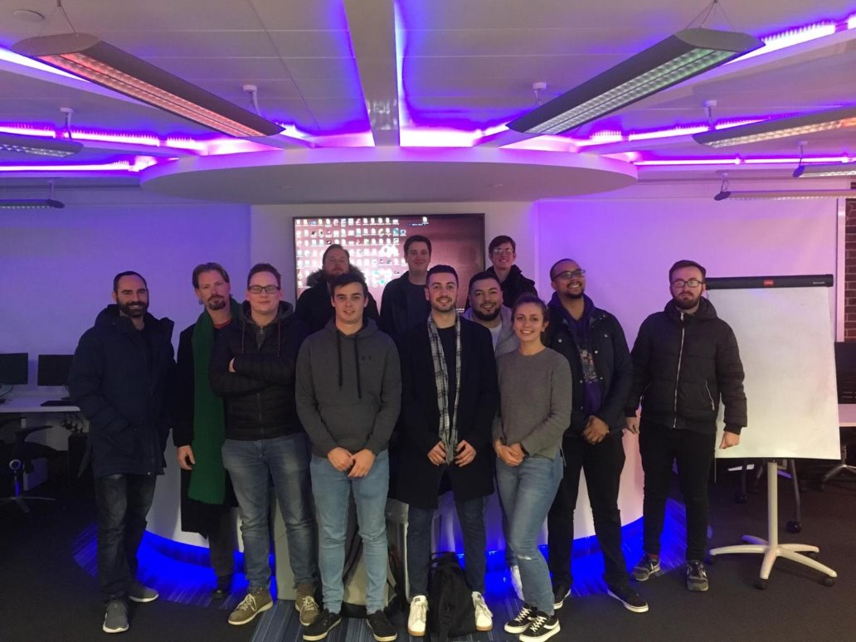
My Co-hort

Slide 34
Any questions?
Notes:
Standard title slide

