Slide 1
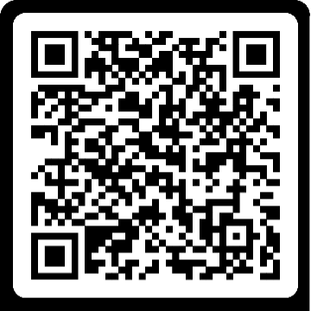
Primary Care Multiprofessional Supervision Courses:
Supervisor Community of Practice Lunch and Learn sessions
YEAR
2025
MAR 13/28
APR 11/24
MAY 15/30
JUN 6/12
JUL 10/25
Reflective Practice in Supervision
Accountabilities and responsibilities in supervision
Understanding learning theories and styles
Maintaining competence as a supervisor
Creating a safe environment for supervision
A forum for all clinicians to maintain educator and supervisor knowledge, skills and behaviours on a regular basis. Virtual 30-minute lunchtime sessions.
DEC 12/18
NOV 6/20
OCT 2/10
SEP 5/18
AUG 8/14
Scan to book
Overcoming barriers to effective supervision
Types of Clinical Supervision
Delivering individualised support for supervisees
Supporting supervisees in difficulty
Benefits of supervision
England.primarycareschoolyh@nhs.net

Slide 2
Primary Care Multiprofessional Supervision Courses:
Introduction to Clinical Supervision Training
YEAR
2025
MAR 6
APR 4/10
MAY 8
JUN 12/20
JUL 3
4th Face to face
10th Virtual
12^{h} Face to face
20th Virtual
Virtual
Virtual
Virtual
A half day course for clinicians working in a primary and/or community care that will equip attendees with skills and knowledge to provide clinical supervision within the workplace.
DEC 5/18
NOV 7
OCT 9/16
SEP 12
AUG 15/21
Scan to book
^{5th} Virtual
18th Face to face
Virtual
9th Face to face
16th Virtual
Virtual
15th Face to face
21st Virtual
England.primarycareschoolyh@nhs.net

Slide 3
Primary Care Multiprofessional Supervision Courses:
Introduction to becoming an Educational Supervisor
YEAR
2025
MAR 7/14
APR 3
MAY 2/9
JUN 19
JUL 4/17
7th Virtual
14th Face to face
Virtual
2nd Face to face
9th Virtual
Virtual
4th Virtual
17th Face to face
A half day course for clinicians working in a primary and/or community care that will equip attendees with an understanding of being an educational supervisor.
DEC 11
NOV 13/21
OCT 17
SEP 4/19
AUG 7
Scan to book
13th Virtual
21st Face to face
4th Virtual
19th Face to face
Virtual
Virtual
Virtual
England.primarycareschoolyh@nhs.net

Slide 4
Primary Care Multiprofessional Supervision Courses:
Intending GP trainers and Multiprofessional Supervisor Pathway
YEAR
2025
MAR 20/27
APR 17/24
MAY 22/29
JUN 19/26
JUL 17/24
Day 1 20
Day 2 27
Day 1 17
Day 2 24
Day 1 22
Day 2 29
Day 1 19
Day 2 26
Day 1 17
Day 2 24
1.5 / 2-day virtual multi-professional course providing the knowledge and skills required to be an effective educational supervisor. Aimed at all clinicians working in primary and community care.
DEC 4/11
NOV 20/27
OCT 23/30
SEP 18/25
AUG 21/28
Scan to book
Day 1 04
Day 2 11
Day 1 20
Day 2 27
Day 1 23
Day 2 30
Day 1 18
Day 2 25
Day 1 21
Day 2 28
England.primarycareschoolyh@nhs.net

