Slide 1


SY Primary Care Workforce & Training Hub
in association with Sheffield Hallam University
Practice Nurse PS/PA Update
Monday 26th February 2024 12.30-2pm
Please note: this session is being recorded

Slide 2
Agenda:
12.30: Welcome, Agenda & Introductions
12.45: Sheffield Hallam University Update – MYEPAD/ Q&A
13.45: SY Primary Care Training Hub Update:
-New website
-Nurse VTS update
-Placements support offer
-Training Hub news
14.00: Close

Slide 3
Abbie Foster – Project Co-Ordinator/Placements Lead & Sheffield Place Area Lead
abbie.foster3@nhs.net
Jo Mirza – Project Manager/ Doncaster Place Area Lead
jo.mirza@nhs.net
Amy Collins – Project Manager/ Rotherham & Barnsley Place Area Lead
amy.collins10@nhs.net
Lisa Sharp – Legacy Nurse Mentor – SY Placements Support
lisa.sharp2@nhs.net

Slide 4
MYEPAD Support Session
Aims:
Raise awareness of how to complete a Myepad
Discuss student/PA/PS responsibilities
Resolve any technical queries
Eve Rawling
Joanne Bedford
Angela Ellis
David Beard

Slide 5
Plan for completion:
01. Placement Details, Orientation and Initial interview
02. Midpoint Interview, Midpoint Professional Values
Identify learning needs
Set targets
Agree on dates for assessment
03. Proficiencies, Episodes of Care, Meds Management
04. Final Interview, Final Professional Values, OAR
05. Action Plan
Complete if any concerns
Contact Link Lecturer
Agree plan and timeframe
Reflect on achievements
Identify development needs
Ensure timesheets authorised
Notes:
pull up Myepad and go threw each interview ect these will be pre-populated in 2022 Myepad under joannes name to use as an example.

Slide 6
Timeline for 7 week placement
Week 1
Weeks 3-4
Midpoint Interview & Professional Values
Proficiencies
Episodes of Care
Medicines Management
Reflection Hours
Placement Details,
Orientation
Initial interview
Agree date for midpoint review
Weeks 1-3
Weeks 6-7
Proficiencies
Episodes of Care
Medicines Management
Reflection Hours
Timesheets
Final Interview
Final Professional Values
OAR
Timesheets
Action Plan
Proficiencies
Episodes of Care
Med Management
Notes:
go over Myepad take people threw

Slide 7
Make-up Placements
This applies to make up placements only
For 3 week placement or less:
Professional Values, Final Interview, Timesheets logged, OAR completed
For 4 week placement or longer:
Follow regular process
Information confirmed by Practice Placement Learning Lead, Jan 2024
Contact link team for your area if concerns

Slide 8
Timeline for 3 week makeup placement
Week 1
Week 2
Placement Details
Orientation
Initial Interview - Optional
Midpoint Professional Values
Hours
Week 3
Final Interview
Final Professional Values
OAR
Hours
Notes:
go over Myepad take people threw

Slide 9

Any questions?
It is the student's responsibility to highlight their development needs
Dependent on what year AND what placement the student is on will depend on the types of proficiencies need completing
Episodes of Care, Proficiencies and Meds Management may have been completed on a previous placement in that Part

Slide 10



Useful Links
Link Lecturing Contact Details
SHU Nursing Placement Website
Practice Toolkit

Slide 11
Any questions?

Slide 13

SY Primary Care Workforce & Training Hub Update
New website: https://yhtraininghubs.co.uk/south-yorkshire/
Notes:
Schemes section – Student Nurse Placements page with information for practices who are interested in taking students, also links to Practice Educator update page (recording of most recent PSPA update) plus information on MYEPAD and the PARE placement database

Slide 14


SY Primary Care Workforce & Training Hub Update
1-year vocational training programme for new-to-practice nurses
NHSE funding for Preceptorships is being stopped at the end of March 2024
Any nurse currently on the VTS programme will be able to complete it
Training Hub is currently working with partners to find a funding solution to enable the Nurse VTS to run in future
Nurse VTS update:
Emma Thompson
VTS Lead Nurse Manager
emma.thompson6@nhs.net ​
Notes:
Award-winning 1-year vocational training programme for new-to-practice nurses, won the Nursing Times Preceptorship of the Year 2021 and has just been awarded the National Preceptorship for Nursing Quality Mark (Jan 2024) Offers a comprehensive GPN training package which practices who are employing their own new-to-practice nurses can access free of charge (funded through NHSE Preceptorship funding) Has provided a pipeline of GPN nurses into SY over the past few years (approx. 40 per year)

Slide 15
SY Primary Care Workforce & Training Hub Update
Placements support:
Advice on Supervisor/ Assessor training
MYEPAD advice
Updating your practice PARE profile
Support with student issues
Signposting to SHU link teams
Advice around meeting competencies in primary care
Help for practices new to taking students
Face-to-face visits and Teams calls available (Mondays)
Lisa Sharp
Legacy Nurse Mentor - Placements
lisa.sharp2@nhs.net

Slide 16
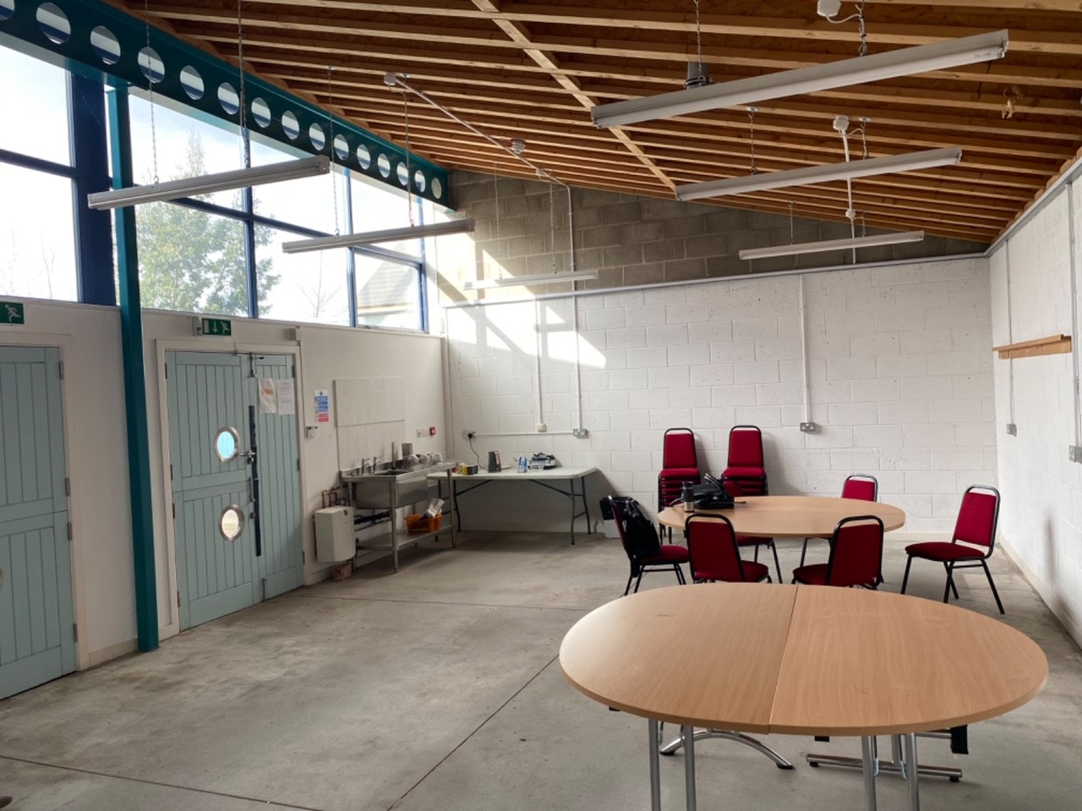
SY Primary Care Workforce & Training Hub Update
SY Training Hub news:
New home for the Training Hub from March 2024
Located in Sheffield – Manor Green Estates studio
Conferencing facilities for training– Manor Oaks house
Free onsite parking & Rhubarb Café catering
Aim: to expand provision of training for SY primary care staff & be a centre for innovation/ simulation (placements, etc.)
Notes:
Long term aim – to have similar sites across all SY Place areas

Slide 17
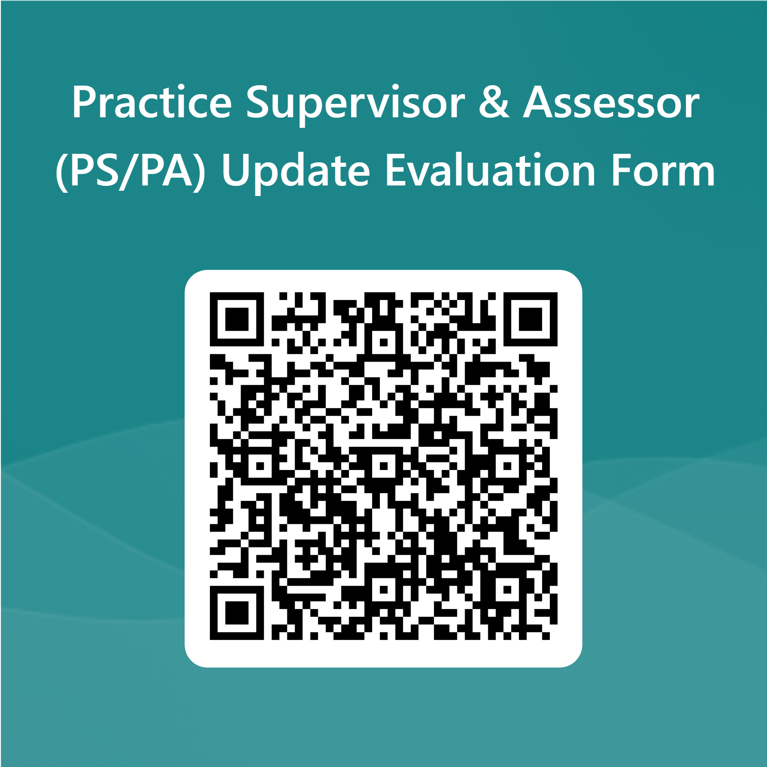
SY Primary Care Workforce & Training Hub Update
Other information:
Next Sheffield Hallam student nurse placement dates:
01/04/24 for 14 weeks (3rd years – consolidation placement) – already confirmed
10/06/24 for 8 weeks (1st years) will be asking for placements in April
PS/PA training Incentive funding: none currently available, please contact us to be added to our waiting list
PS/PA session evaluation: complete to receive a certificate of attendance for Revalidation

Slide 18

Thank you for your time today & your continued support with student placements in South Yorkshire GP!

